Slide 1




Advanced signal processing Group Project presentation
Presenting TP3 and TP4
By Marc Palomer and Cinthia krämer

Slide 2
Tp 3 Signal Processing Techniques for detecting SLEEP STAGES in Spectral Analysis of Physiological Signals
Database and Signals
Methodology and Results
Cardiac Frequency
Heart Rate Variability
Respiratory Frequency
EEG Signal Analysis
Analysis of the relationship between cardiac, respiratory and EEG parameters with the stages of sleep and respiratory events

Slide 3

Database and Signals
2018 Computers in Cardiology Challenge database on physionet
1985 subjects
Monitored during a polysomnographic (PSG)
Our subject: tr03-0083
sleep stage annotation by physicians: wakefulness, stage 1, stage 2, stage 3, rapid eye movement (REM), and undefined.
Signals
EEG : 6 electroencephalographic (EEG) channels based on the International 10/20 System
EMG: channel measured at the chin
ECG: channel below the right clavicle near the sternum and over the left lateral chest wall
Respiration: 2 channels from the abdomen and chest.

Slide 4
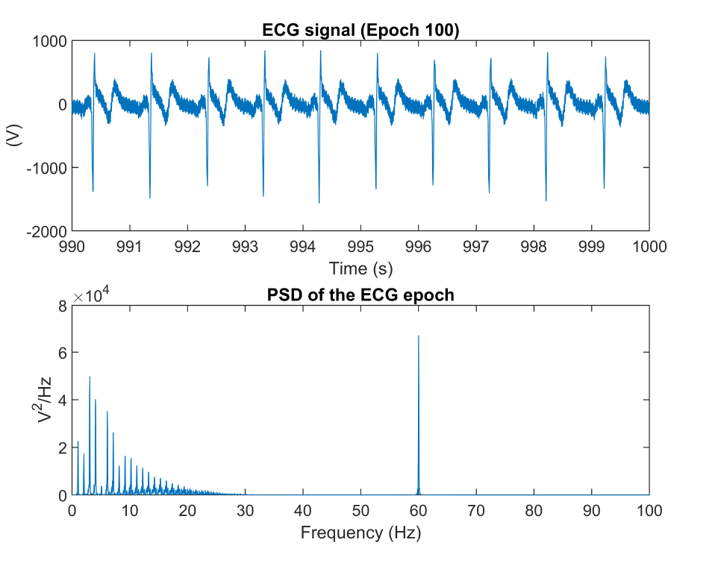
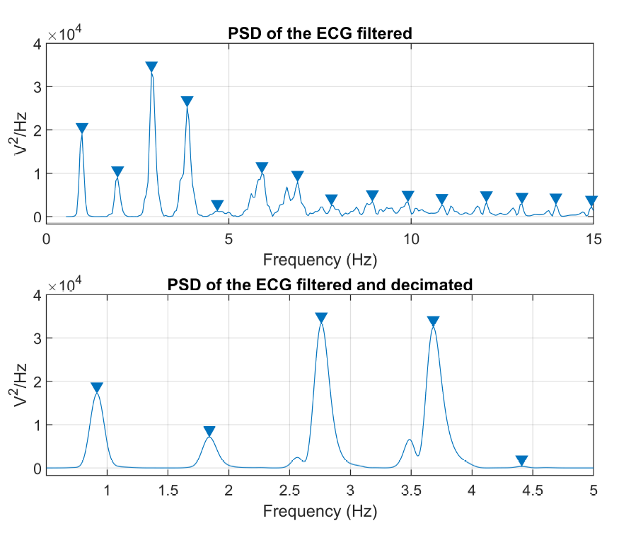
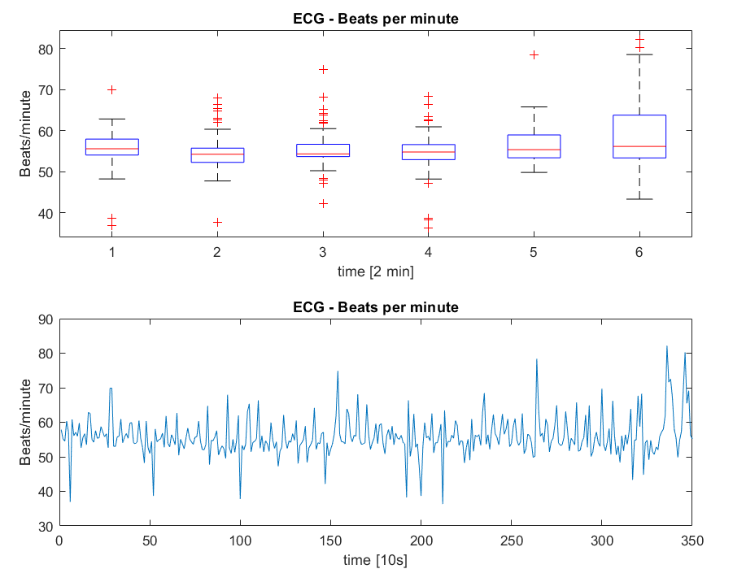
Methods:
Cardiac Frequency with PSD
Detect fundamental frequency by identifying PSD peaks
1. Preprocessing of the signal
58/62 Hz Bandpass filter
40 Hz Low-pass filter
Decimation to fs = 2 and 4 Hz Low-pass filter
2. Use periodogram() and findpeaks() on a 10s section
3. Identify weaknesses in detection
Exclude peaks above 4 Hz
Exclude detected CFs below 35 BPM
4. Implement a loop applying the detection for the whole signal

Slide 5
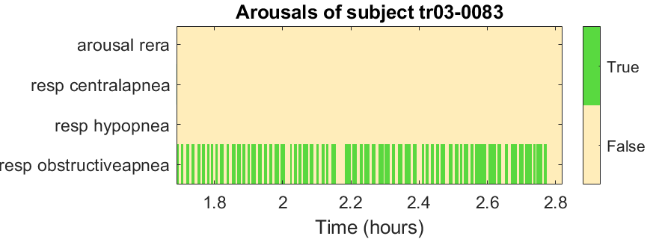
Results and Conclusion:
Cardiac Frequency with PSD
Results
Detected CF
Average 60 BPM
Median 56 BPM
Outliers +- 20 BPM
Conclusion
No arousal detection
Possible reasons
10s sections too small
Distorted or noisy PSD
[10 s]
Extreme values due to arousals or wrong peak detection?

Slide 6
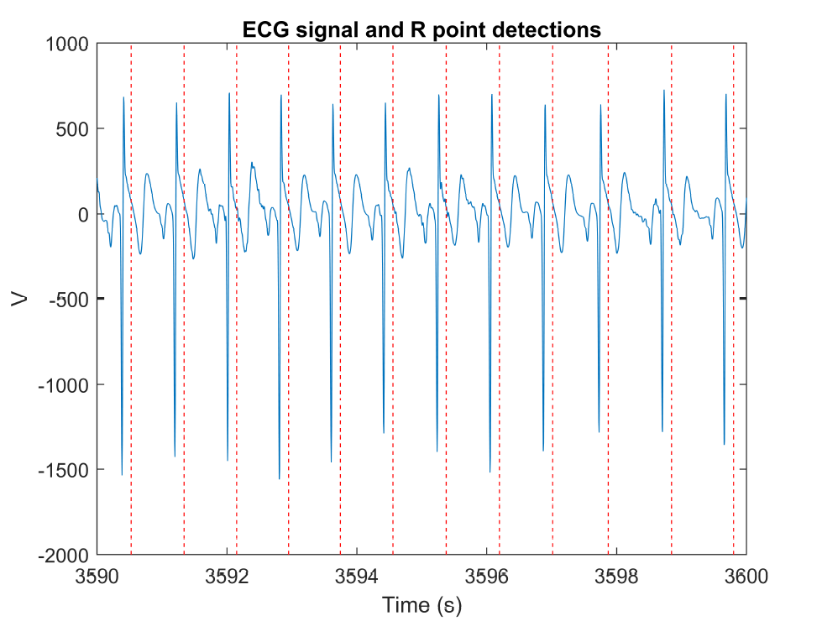
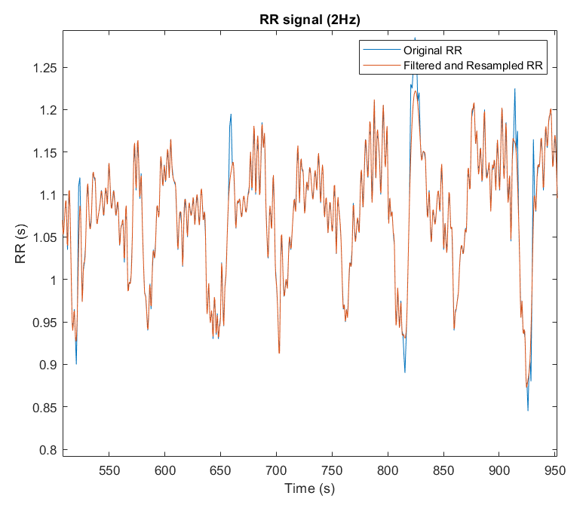
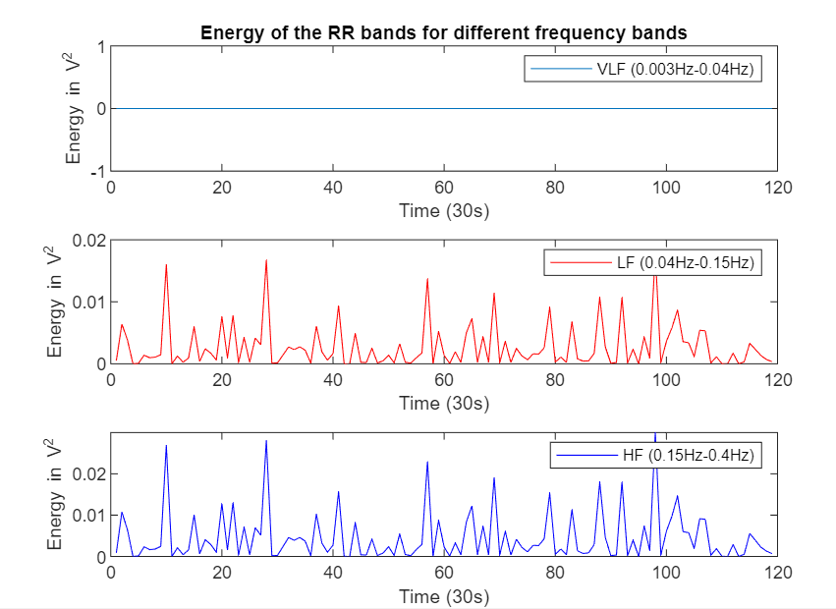
Method:
Heart Rate Variability
Identify evolution of VLF (0.003 - 0.04), LF (0.04 0.15), HF (0.15 - 0.4) frequency bands of the RR signal
1. Use Pan-Tompkins method for RR-Intervals
2. Correct frequency to 2 Hz with spline interpolation
3. Use powerband() to extract VLF, LF and HF

Slide 7
Results and Conclusion:
Heart Rate Variability
Results
Detected HRV
VLF: No variability
LF: Variability 0 – 0.18 V²
HF: Variability 0 – 0.25 V²
Conclusion
No Variance of VLF
Indicates pathological parasympathetic nervous system (PNS)
Open question:
Physiological reasons for same evolution of LF and HF?

Slide 8
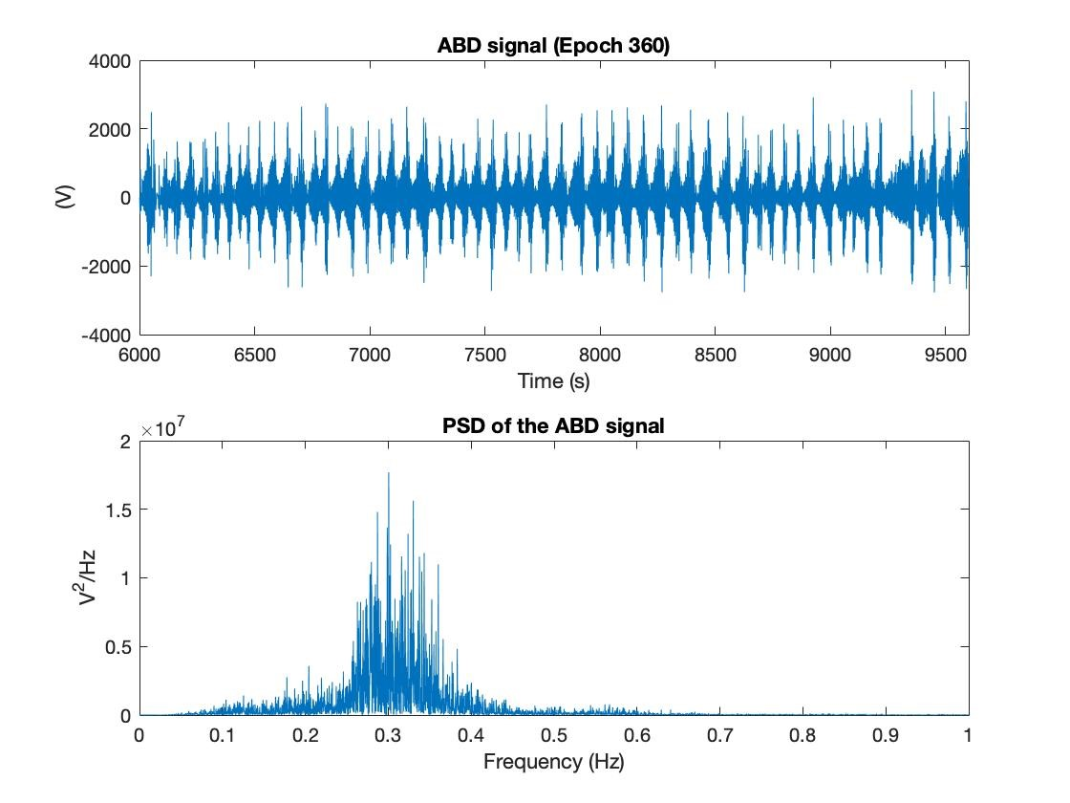
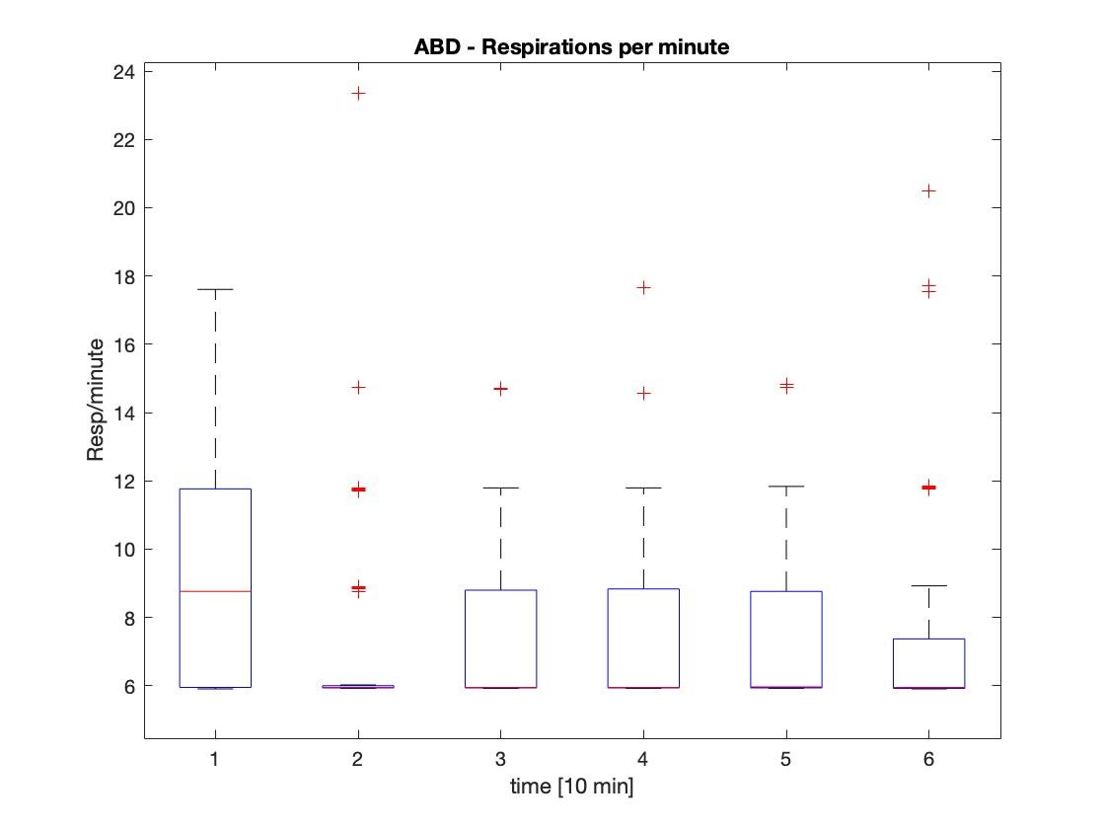
Methods:
Respiratory Frequency with PSD
1. Finding frequency of main peaks in the PSD of respiratory signal
2. PSD of 10 second epoch
3. Plotted in groups of 10 minutes

Slide 9
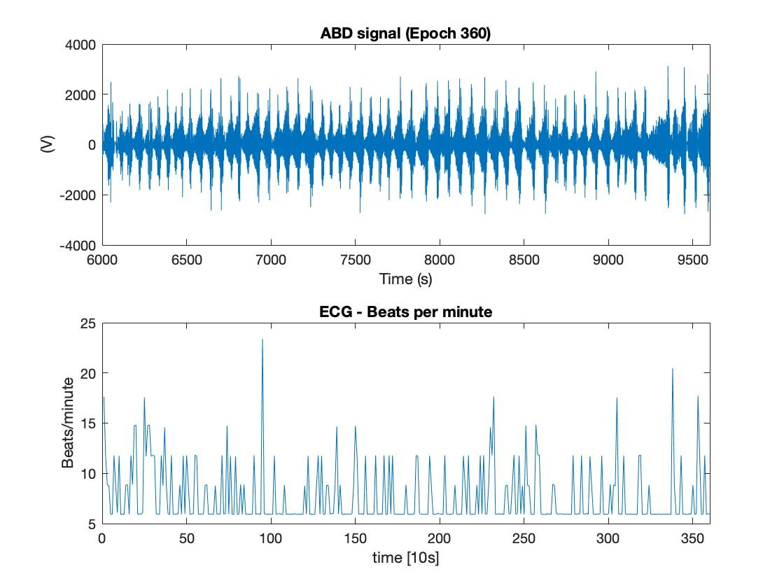
Results Conclusion:
Respiratory Frequency with PSD
Respiratory frequency
Mean: 8 RPM
Median: 6.5 RPM
ABD Breaths per Minute

Slide 10
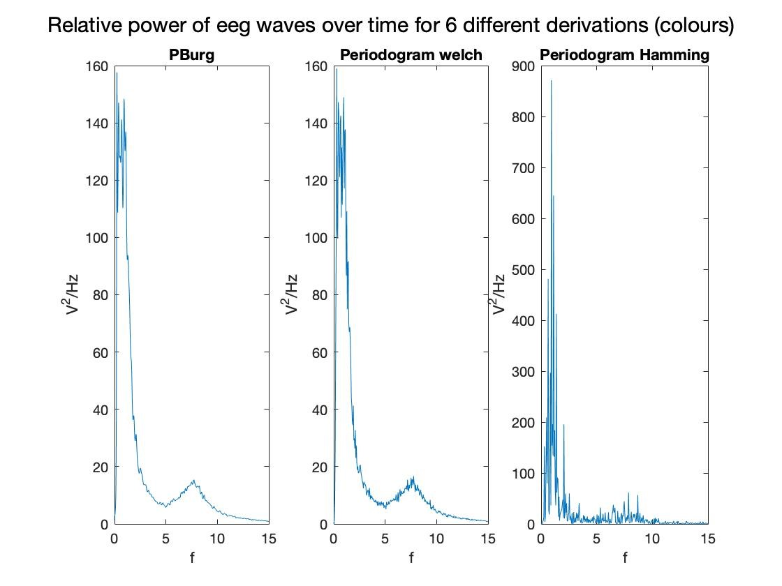
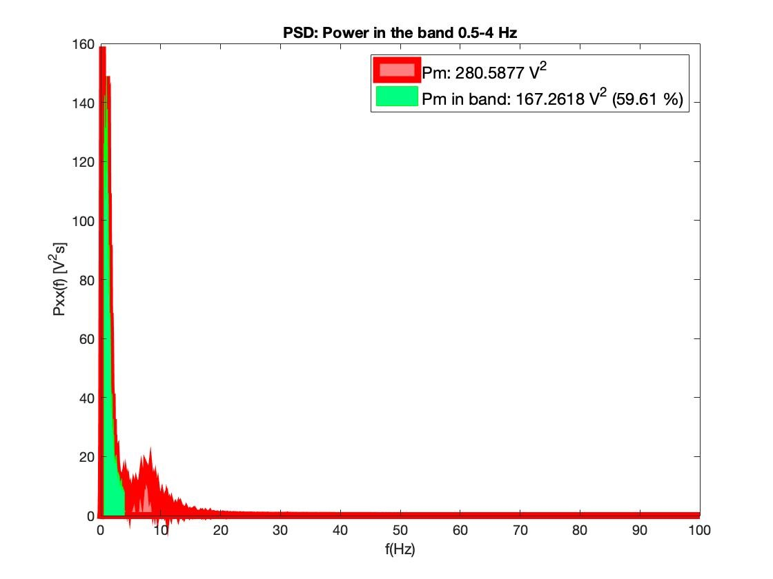
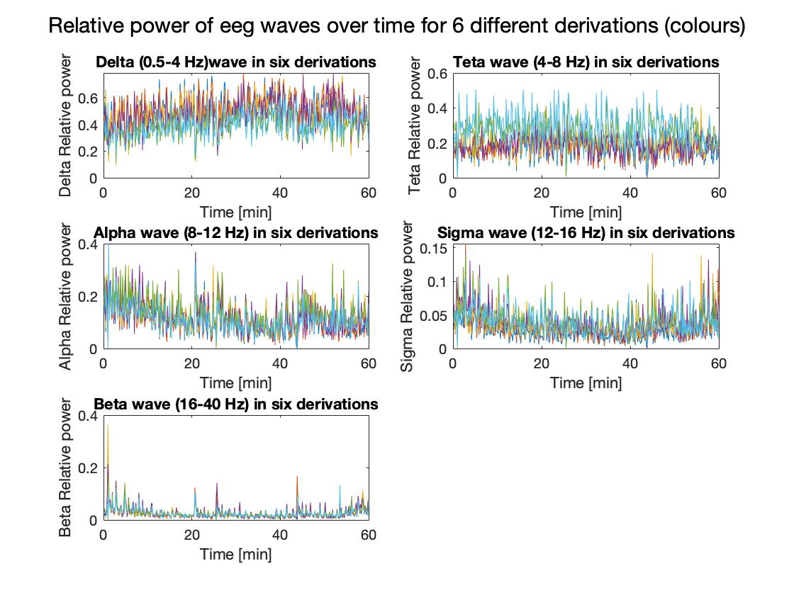
Methods:
EEG Signal Analysis
1. PSD estimation method evaluation
2. Relative Energy (RE) of the frequency band
3. Change of RE over the 10s PSDs (n=360)

Slide 11
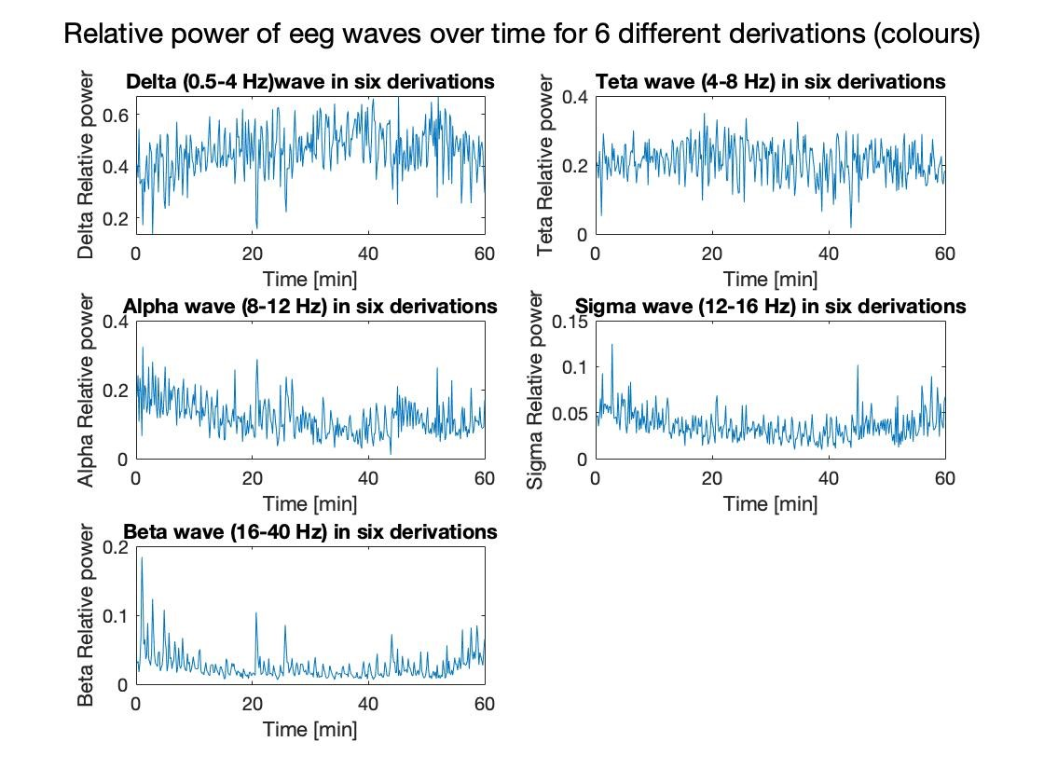
Methods:
EEG Signal Analysis
1. PSD estimation method evaluation
2. Relative Energy (RE) of the frequency band
3. Change of RE over the 10s PSDs (n=360)
4. Averaging as tendency is coherent

Slide 12
Results and Conclusion:
EEG Signal Analysis
Relative decrease in relative energy but for delta (0.5-4Hz)

Slide 13
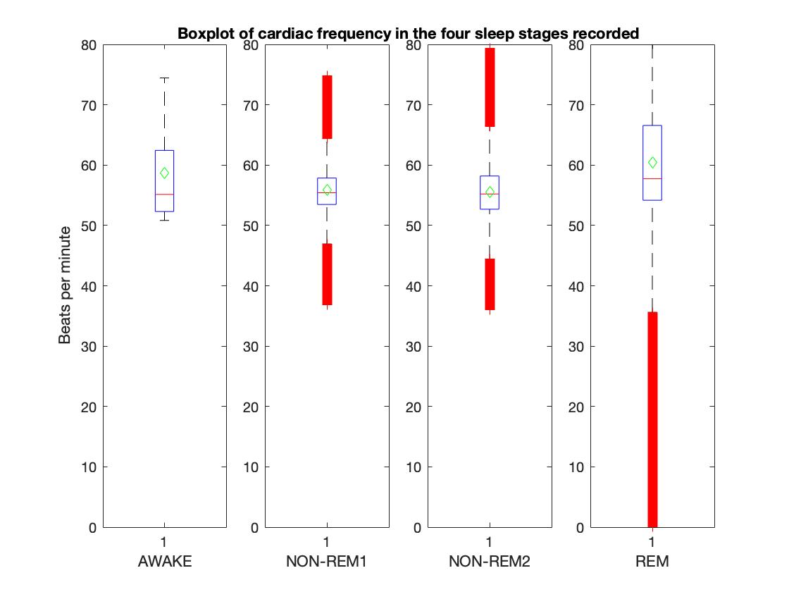
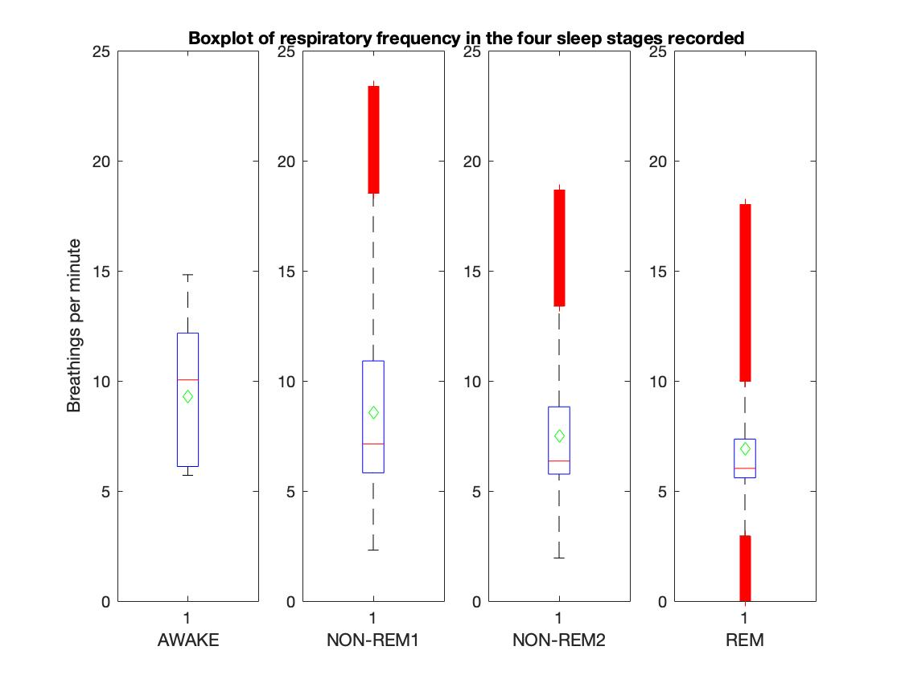
Method:
Relationship between cardiac, respiratory and EEG parameters with the stages of sleep and respiratory events
A boxplot analysis for each of the studied variables
Class depending on sleep stage

Slide 14
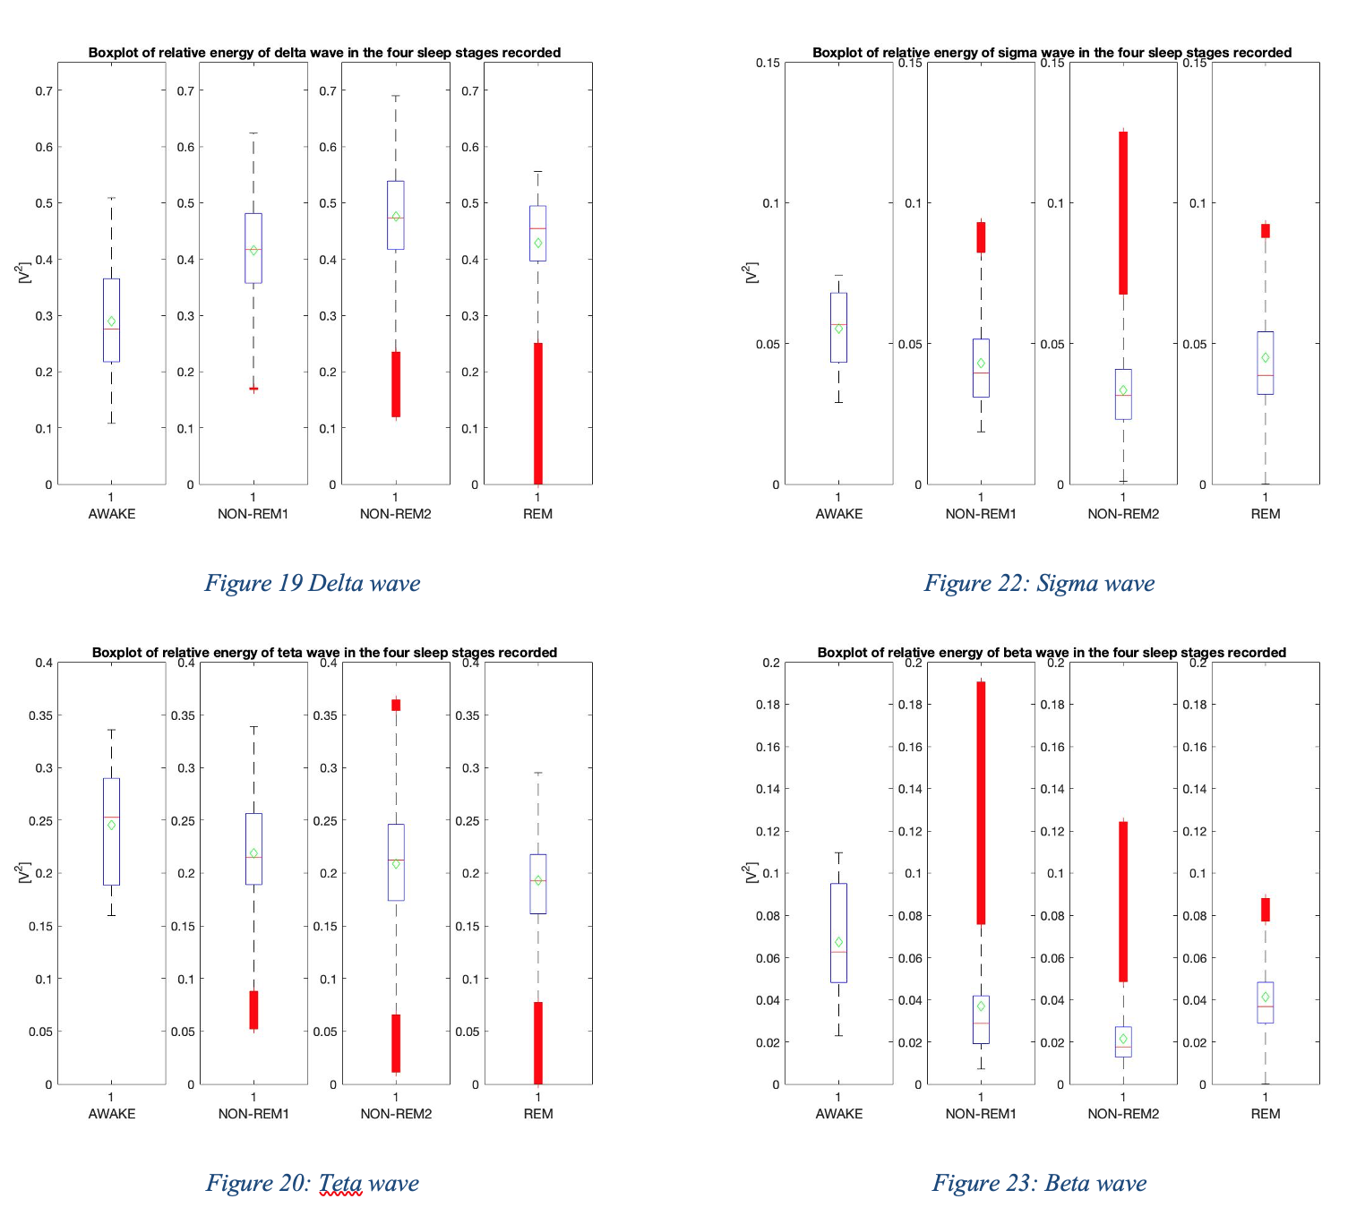
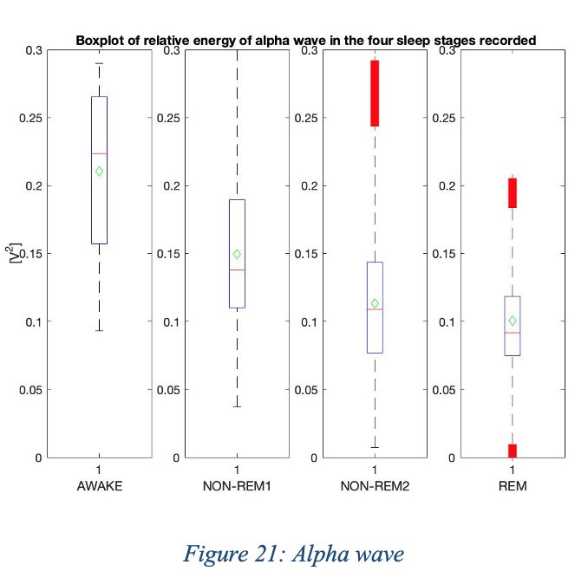
Method:
Relationship between cardiac, respiratory and EEG parameters with the stages of sleep and respiratory events
Same analysis with each of EEG waves

Slide 15
TP3 - Conclusion
Respiratory frequency is the only parameter observed to decrease firmly over sleep stages
EEG waves (but delta) relative energy and cardiac frequency decrease with deepen sleep stages, but increase again in REM
Delta relative energy increases while sleep deepens, but decreases in the REM stage.

Slide 16
Tp 4 Time Frequency Analysis and Characterization of Phonocardiography Signals
Database and Signals
Power Spectral Density Characterization
Time Frequency Representations and Characterization
Characterization and Pathology Classification Algorithm

Slide 17
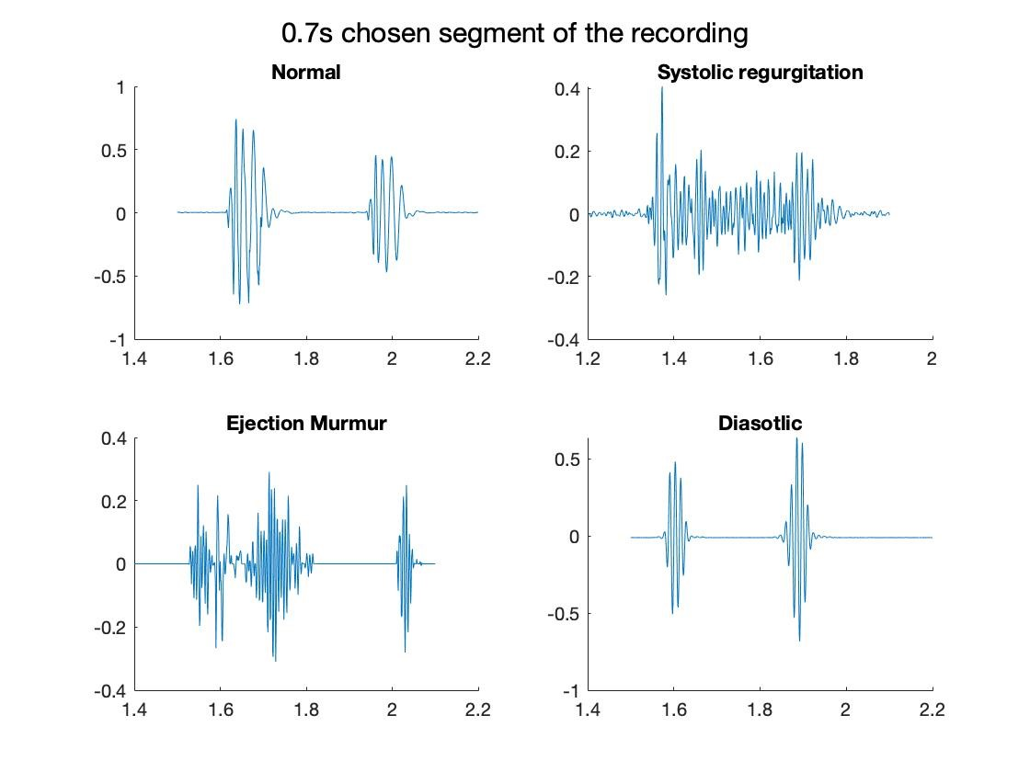
Database and Signals
Data provided from in the virtual campus
Several phonocardiography (PCG signals)
Loaded using leerwav() function
Already decimated signals with
fs = 1000Hz
PCG signals analyzed:
Healthy heart
Diastolic fixed S2 split (n1)
Systolic mitral regurgitation (SMR) (n2)
Heart ejection murmur (EM) (n1)

Slide 18
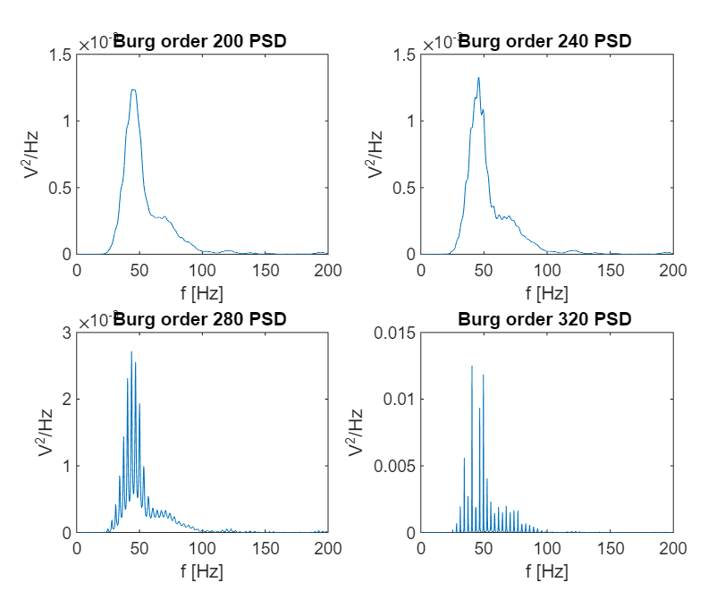
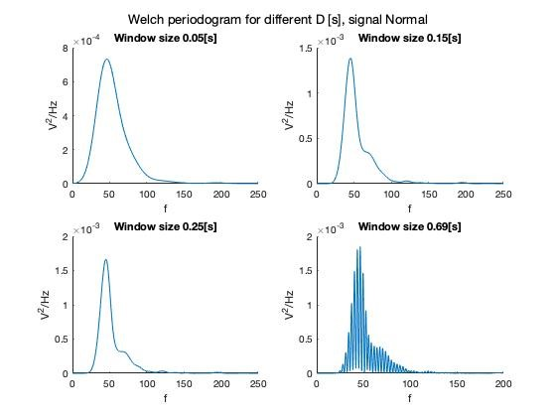
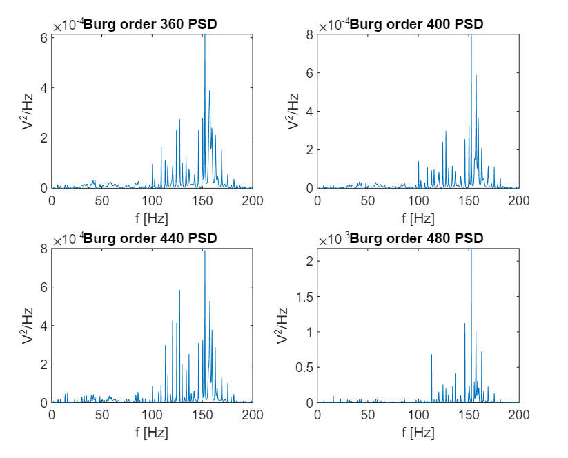
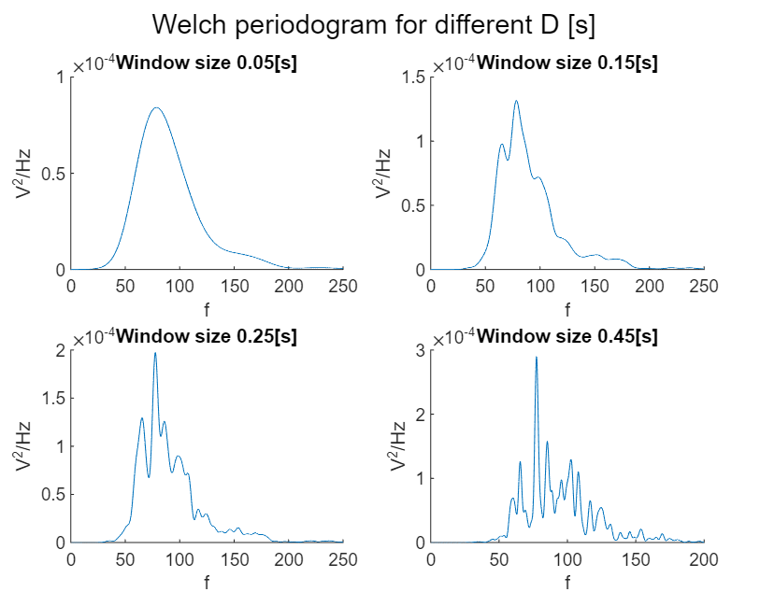
PSD Characterization:
Welch vs. Burg
Quality criteria:
Clear and distinct peaks
Smooth and continuous shape, with minimal noise or distortion
Select Burg method
Better performance for non-stationary signals (SMR)
Short signal sections allow high order for estimation (thus higher confidence)

Slide 19
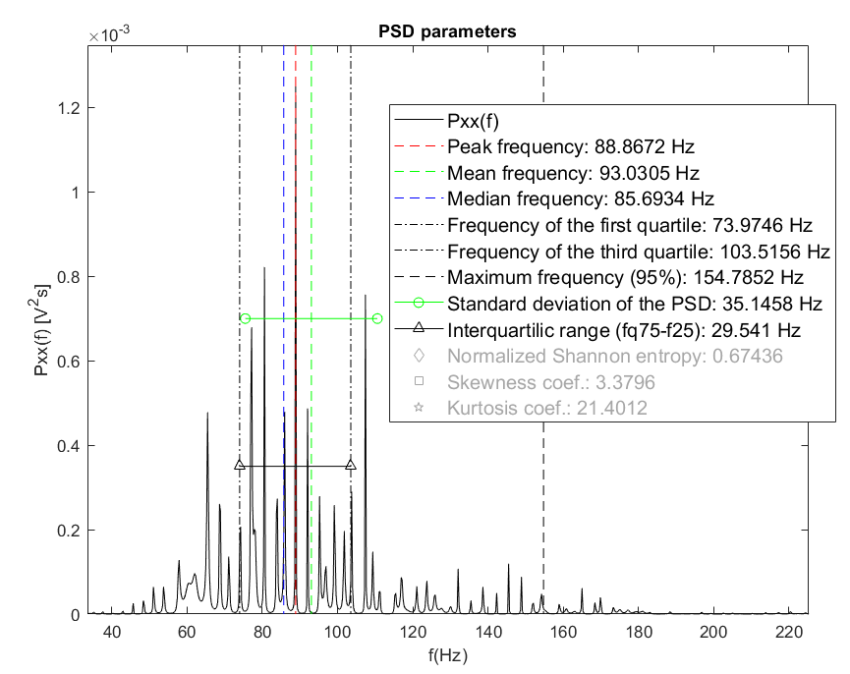
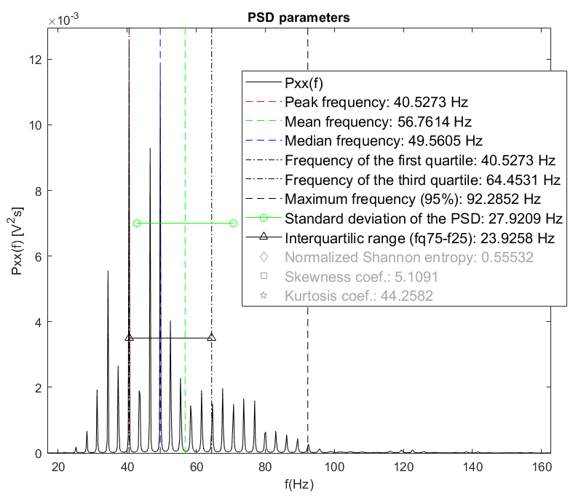
Results and Conclusion:
PSD – Burg
SMR PCG
Healthy PCG

Slide 20
TFR Characterization:
Selection of methods
Spectrogram
Assumes a stationary signal
Scalogram (CWT)
Better performance for non-stationary signals
Reveals frequency and the time at which a particular frequency is present in a signal
Quadratic TFR
Best for non-linear TF relations
Estimation mode decomposition
Better for unknown signals
No direct characterization parameter output

Slide 21
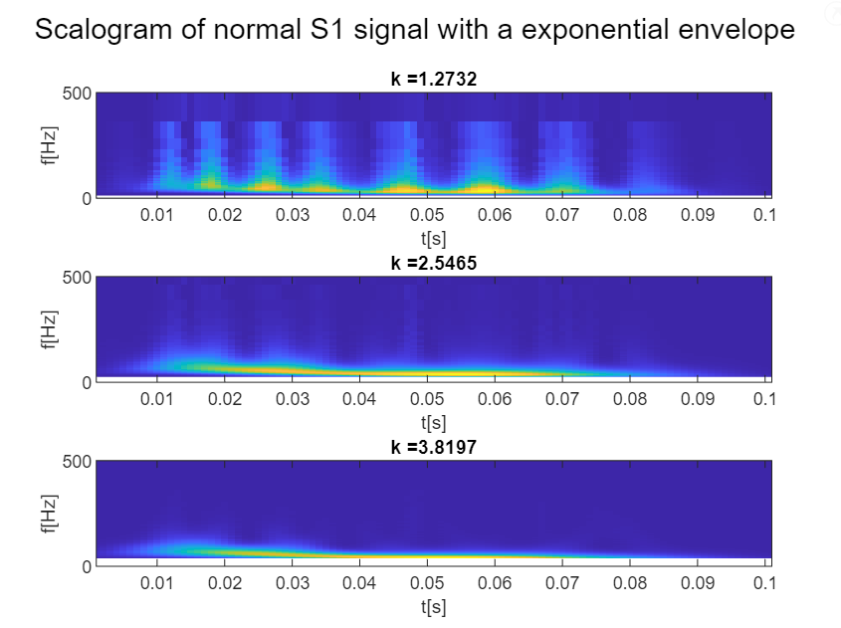
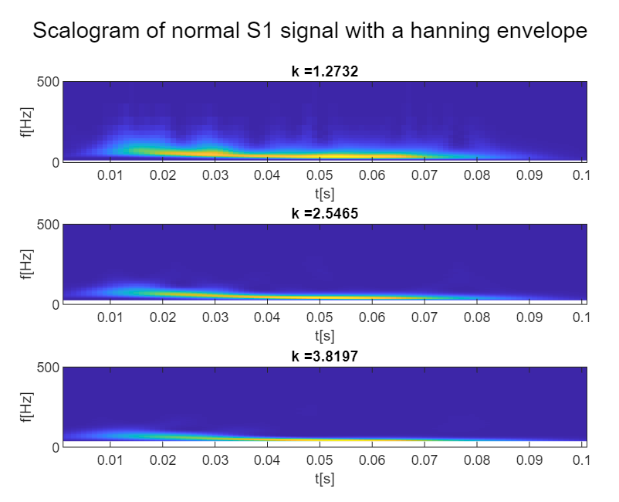
Methods:
Scalogram
Parameters
Morlet wavelet
Number of oscillations 4/pi
Exponential Envelope
Signal divided in first and second heart sound (S1 and S2) if significant pause is present
Reduce computational effort
Characterization of S1 and S2 separately

Slide 22
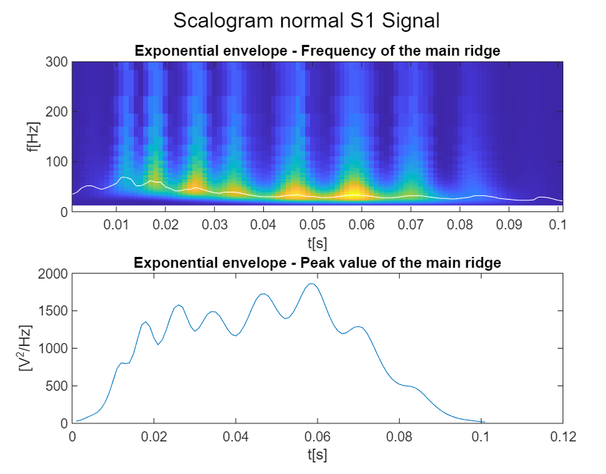
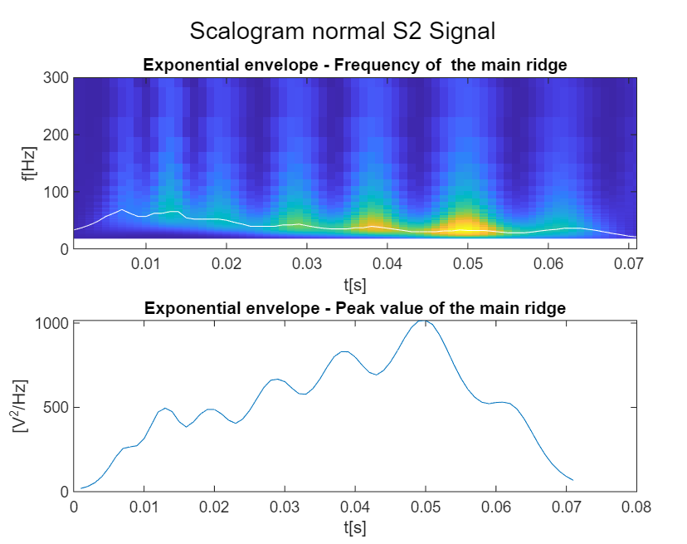
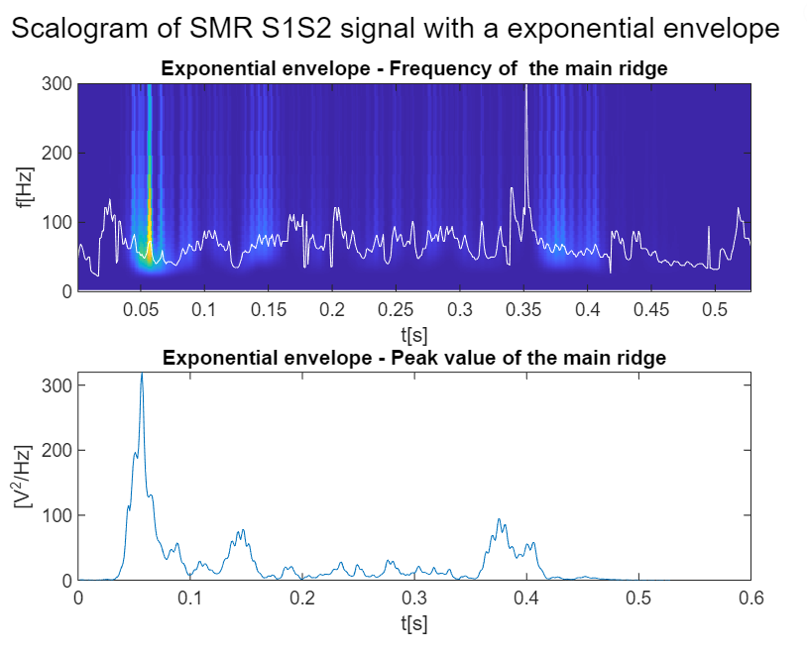
Results:
Scalogram
Healthy PCG
High energy sounds in both S1 and S2 (1800 and 1000 V²/Hz)
Higher energy in S1 than in S2
No energy in-between heart sounds
Similar shape and frequency in S1 and S2
SMR PCG
Low energy sounds in S1 and S2 (300 and 100 V²/Hz)
Murmur in-between S1 and S2
Distinct shapes of S1 and S2
Unknown sound component

Slide 23
Conclusion:
Scalogram
Suited for distinguishing between healthy and pathological PCG
Result agrees with pathology description
Clear differences in amplitude and time evolution
SMR PCG
Murmurs caused by backflow through mitral valve
Less energy due to less loud and less directed (could explain unknown sound after S1)

Slide 24
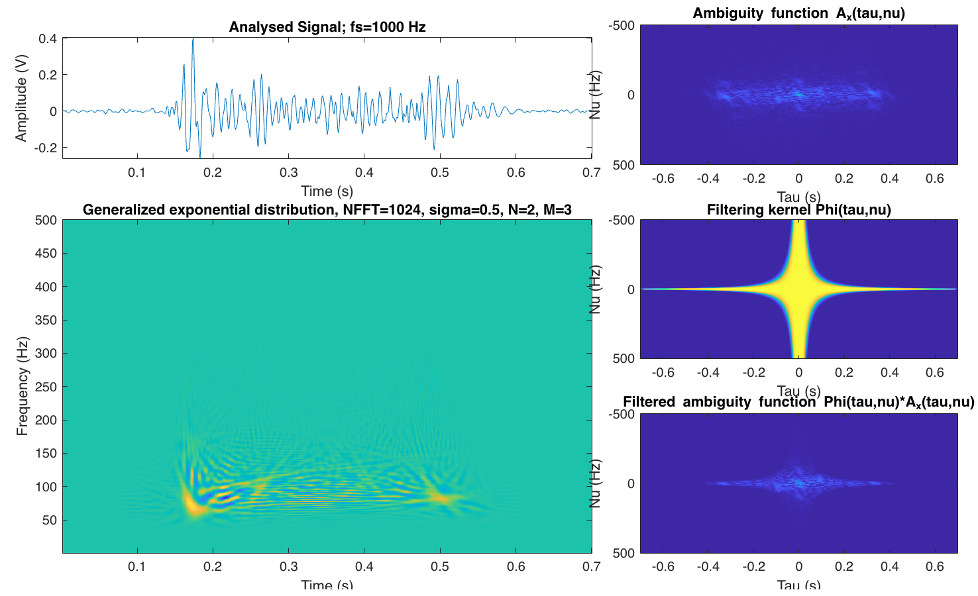
Methods:
Quadratic TFR
Different quadratic TFRs have been tested
Not using ambiguity filter function:
Wigner-Ville (WV)
Using ambiguity filter function to reduce the interferences that typically appear in QTFR
the Bohn Jordan (BJ)
Automatically tunes the parameters
Choi-Williams (CW)
Tunes sigma parameter
Generalised Exponential (GE)
Tunes sigma, N and M.

Slide 25
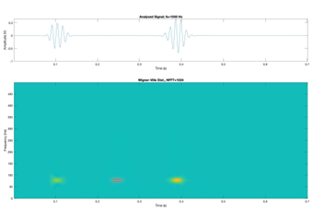
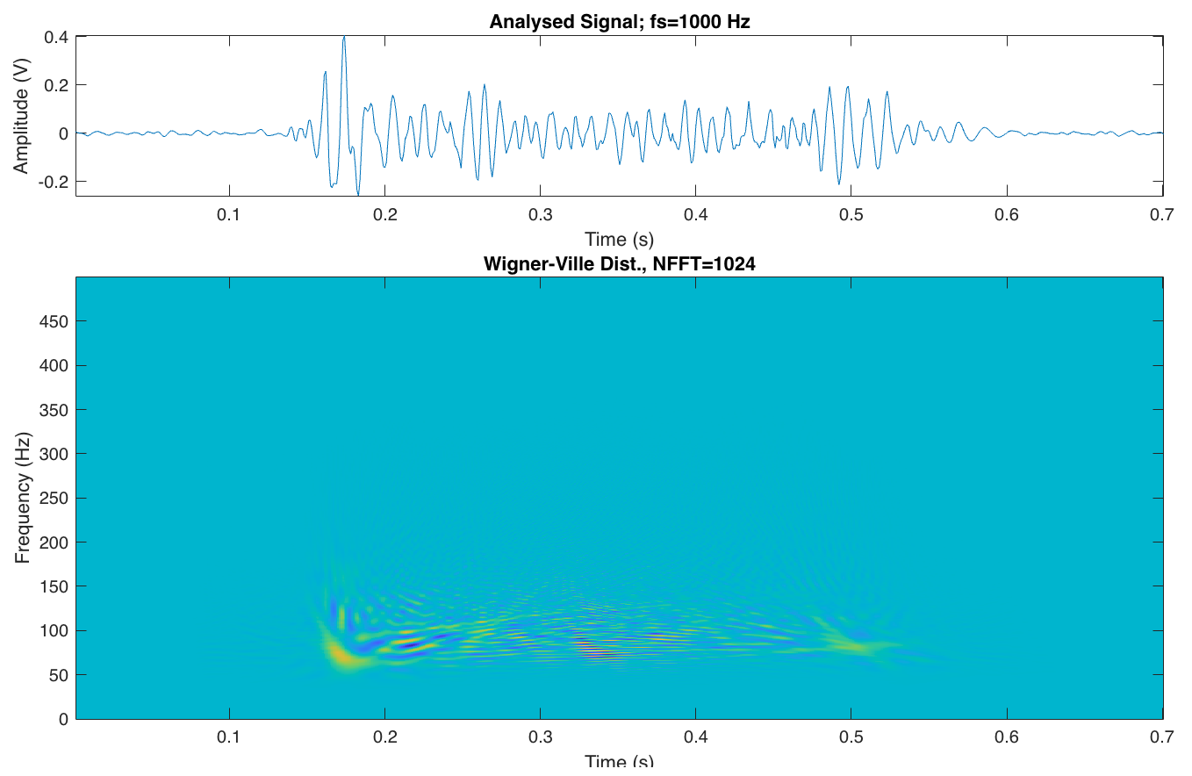
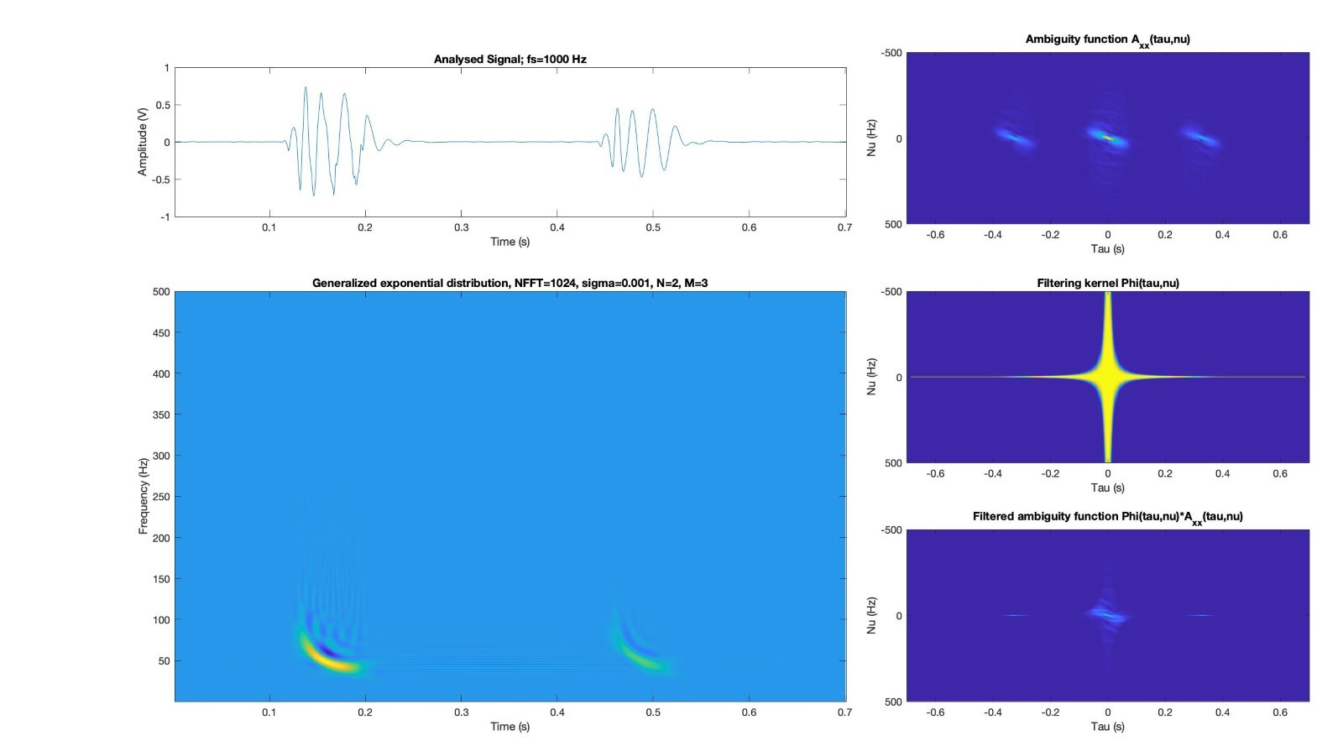
Results and Conclusion:
Quadratic TFR
Healthy PCG
SMR PCG

Slide 26
Method:
Algorithm
Inputs
'signal' of one heartbeat, measuring 0.7 seconds and fs = 1000 Hz
't' time vector for the signal
‘analysistype’ the analysis type; either PSD or TFR
'type' type of pathology, 4 different options (normal, SMR, DFS2, EM)
Functionality
1. check if 'type' is present
Case NO:
2. k-nearest neighbour classification algorithm to determine the type of signal pathology
Proceed
Case YES:
Proceed
3. 4 cases of if statements for each signal type; use the optimal parameters and methods for PSD and TFR for each signal pathology.
...

Slide 27
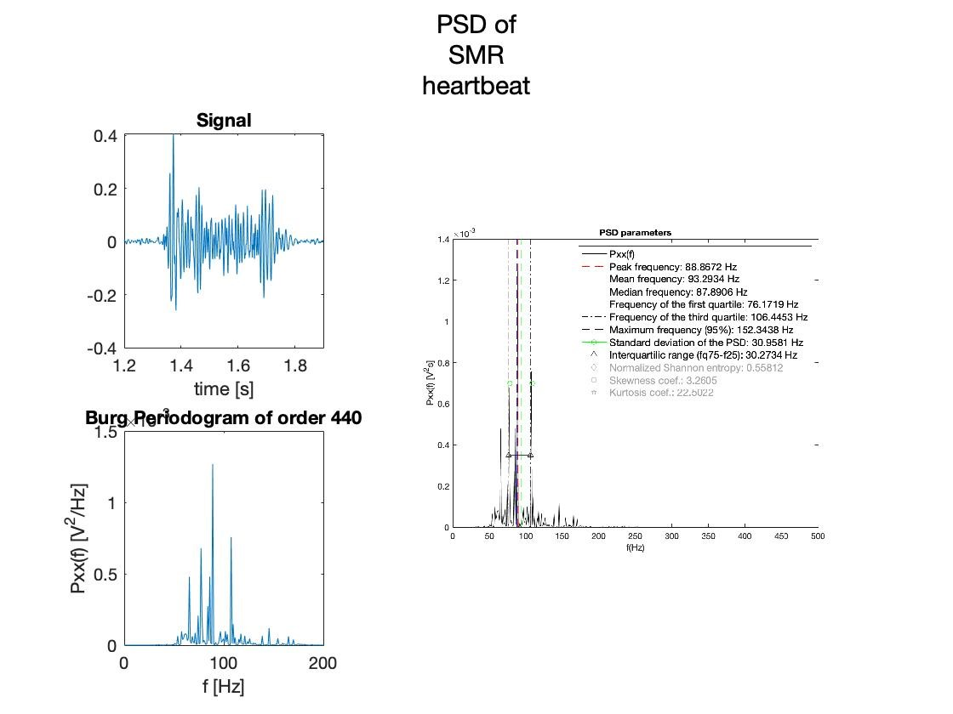
Method:
Algorithm
…
4. If checking the ‘annotationtype’
Case: PSD
5. output is a plot that includes the signal, the PSD estimation made with the Burg method (pburg) and optimized order, and the PSD estimation including PSD parameters using psdpar.m, and struct with the extracted parameters of the PSD
Case: TFR
5. output is a plot that includes the signal, the scalogram with optimized k, the quadratic representations based on the generalized exponential distribution with optimized sigma, N and M, and a struct containing all characterization parameters of the signal.

Slide 28
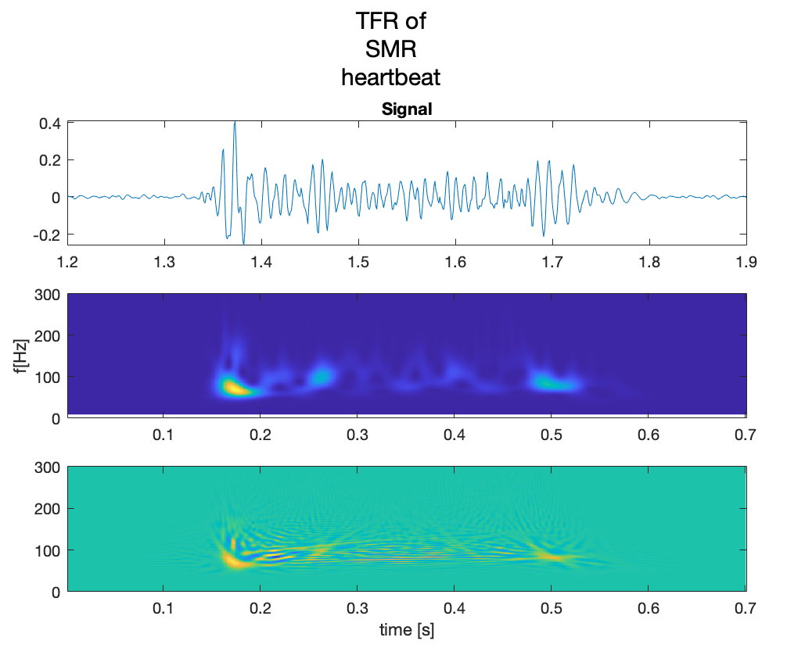
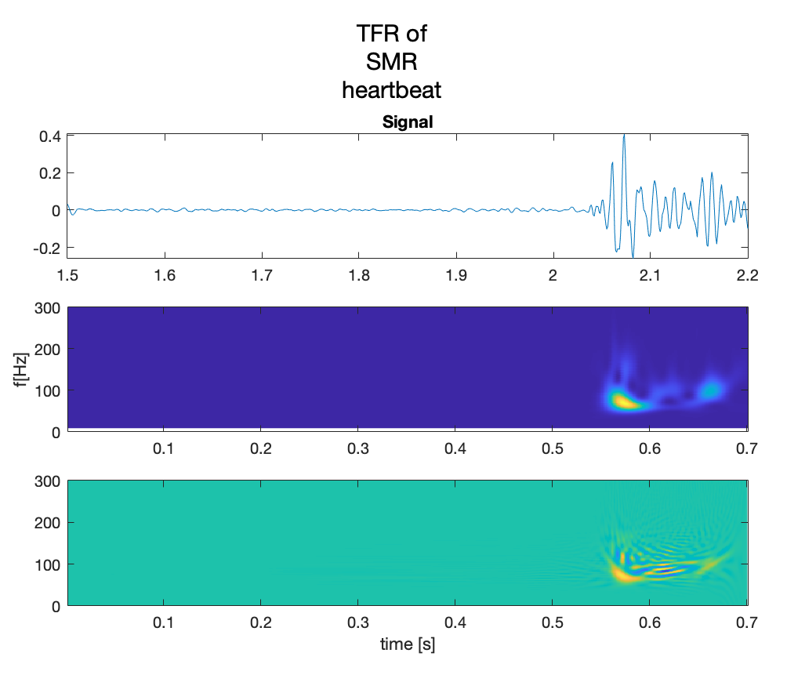
Results:
Algorithm

Slide 29
Thank You for your attention!
Feel free to ask questions!

Slide 30
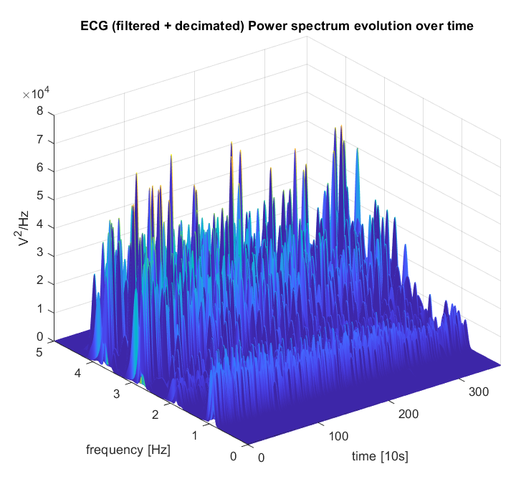
TP3 Back Up Slides (1)
PSD time evolution (CF detection)

Slide 31
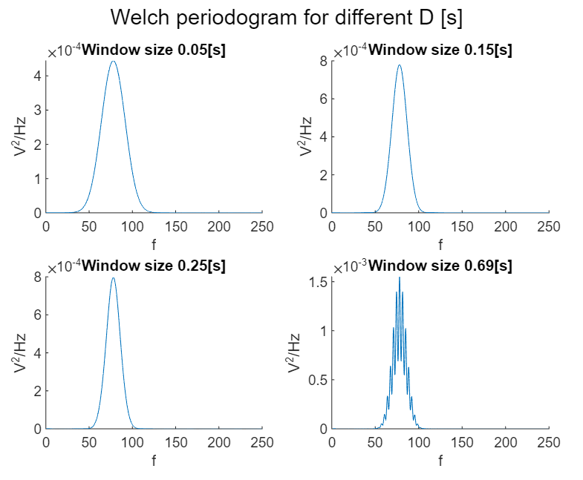
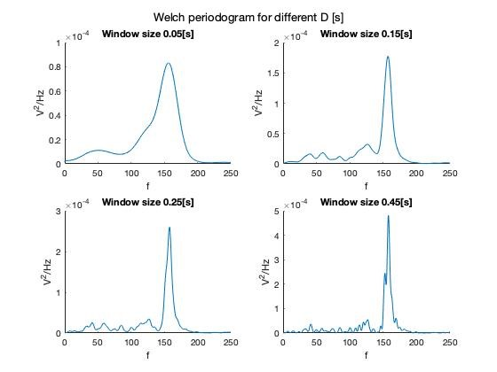
TP4 Back up PSD – Welch
Diastolic Signal
Ejection Murmur Signal

Slide 32
TP4 Back up PSD – Welch
SMR Signal

Slide 33
TP4 Back up PSD – Welch

Slide 34
TP4 Back up PSD – Welch
SMR Signal

Slide 35
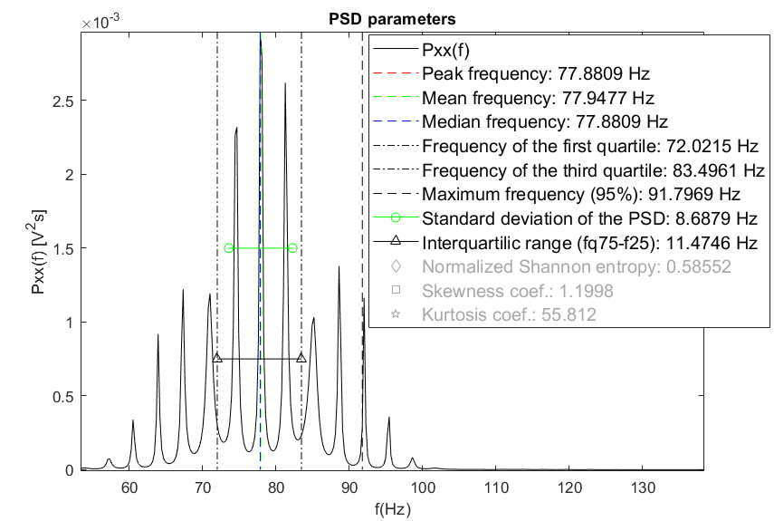
TP4 Back up PSD – Burg
Diastolic PCG
SMR PCG

Slide 36
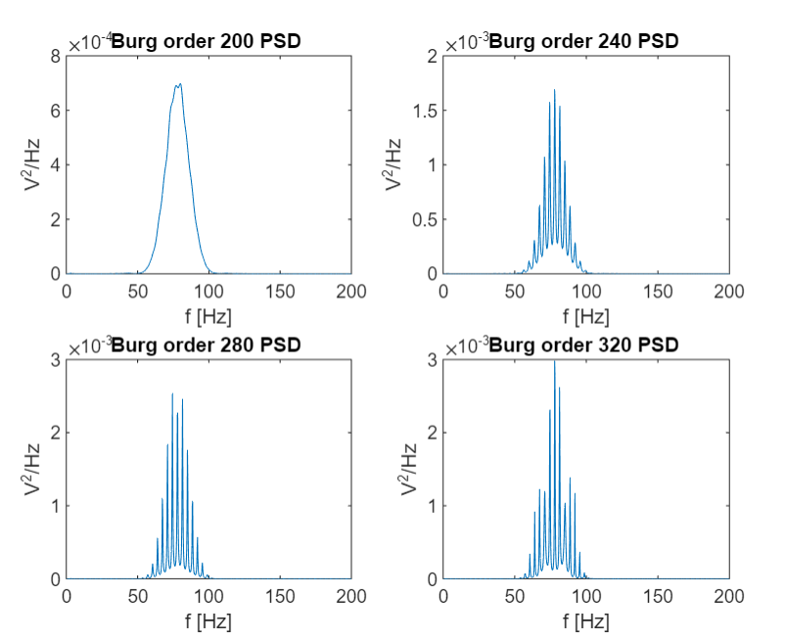
TP4 Back Up Slides (4)
PSD Burg (left DFS2, right EM)

Slide 37
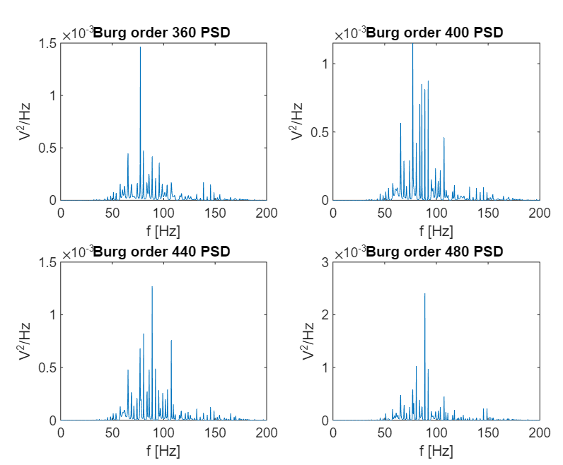
TP4 Back Up Slides (5)
PSD Burg (SMR)

Slide 38
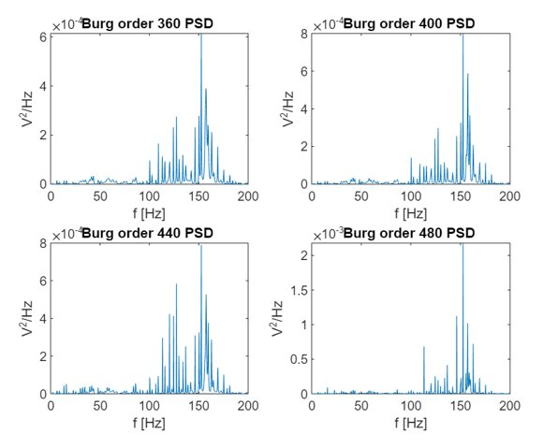
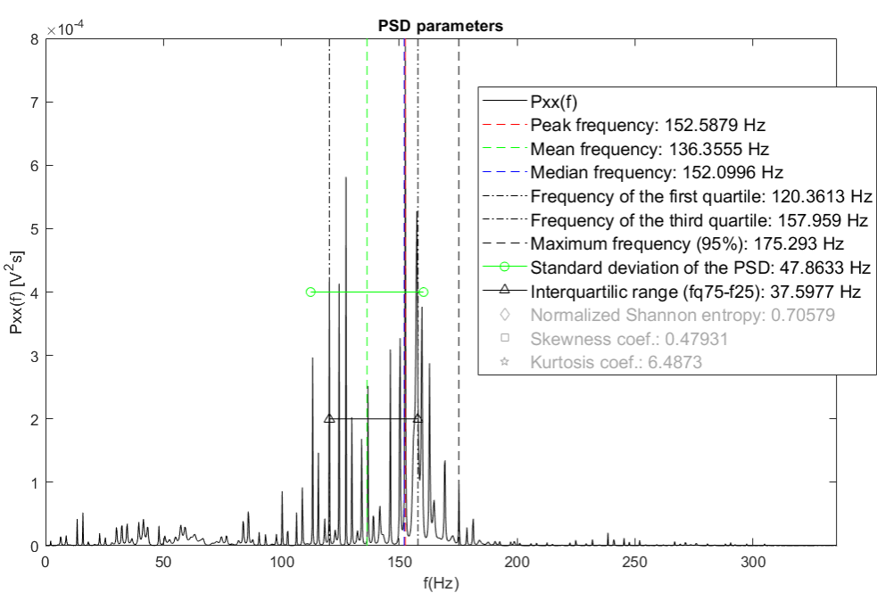
TP4 Back Up Slides (5)
PSD Burg (SMR)

Slide 39
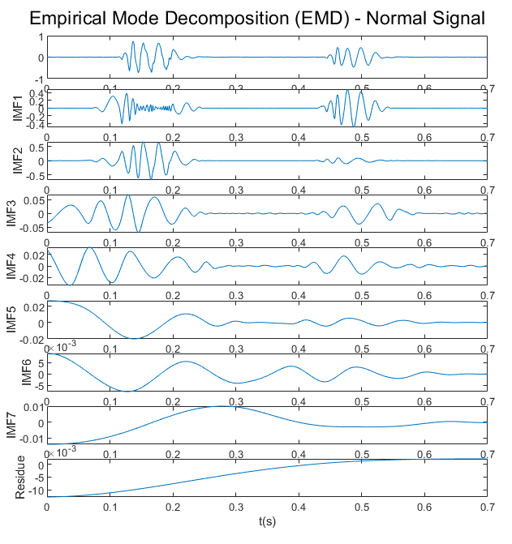
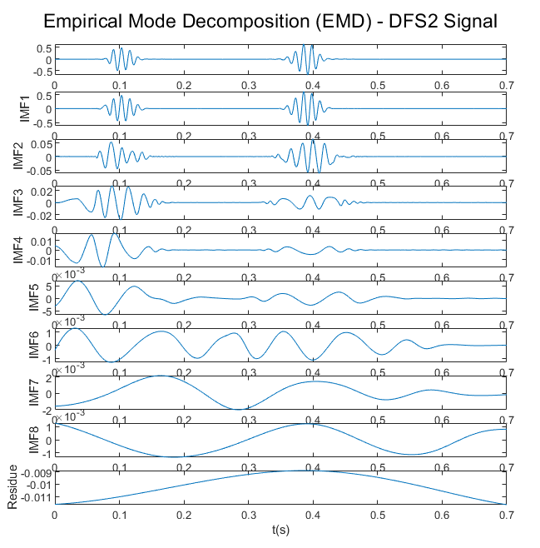
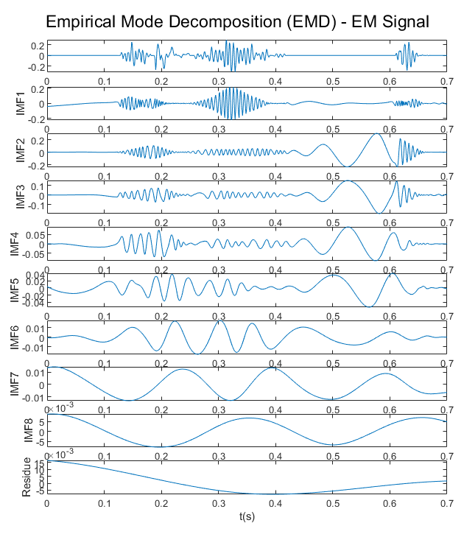
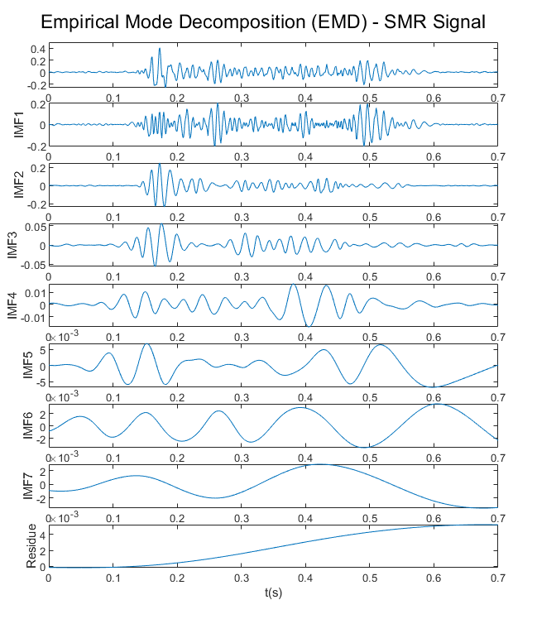
TP4 Back Up - EMD
English

